Slide 1
Final Slide Set 3

Slide 2
Polymorphism & Pointers
CSCE 121
J. Michael Moore
Including slides created by Carlos Soto.

Slide 3
Polymorphism Challenge
We cannot create an instance of an abstract class.
However, we can have a pointer to an abstract class.
If we need a collection of a base class, have a vector of pointers to objects of derived classes in the heap.
vector<BaseClass*> v;

Slide 4
Another Polymorphism Challenge
If we have a vector of pointers, we can iterate through them and call any virtual functions and the derived version will be executed.
What if we want to access attributes/methods specific to the child class?
Cast to derived class (use dynamic_cast)
How do we know if we are casting to the correct class?
No built in way. You can create a virtual function or protected data member that holds the information.

Slide 5
Pointer conversion (implicit)
int main () {
// AbstractParentClass myObj; Not Allowed!
AbstractParentClass* myObj; // totally ok
ChildClass anObj;
myObj = &anObj; // ChildClass* converted
// to AbstractParentClass*
}

Slide 6
Polymorphism example
int main () {
AbstractParentClass* myObj;
ChildClass anObj;
myObj = &anObj;
myObj->virtualFunction();
}
ChildClass’s virtualFunction() is called, even though myObj is an AbstractParentClass*

Slide 7
Polymorphism in a Collection
int main () {
Vector<AbstractParentClass*> things;
// fill things with pointers to // various derived classes
for (int i = 0; i < things.size(); ++i) {
cout << things.at(i)->virtualFunction();
}
}
Regardless of which derived class is at a particular index, the correct version of virtualFunction() is called.

Slide 8
Object Oriented Programming
CSCE 121
J. Michael Moore

Slide 9
Object-Oriented Programming
OOP = inheritance
Inheritance: base and derived classes

Slide 10
Object-Oriented Programming
OOP = inheritance + polymorphism
Inheritance: base and derived classes
Polymorphism: virtual functions

Slide 11
Object-Oriented Programming
OOP = inheritance + polymorphism + encapsulation
Inheritance: base and derived classes
Polymorphism: virtual functions
Encapsulation: private and protected

Slide 12
Graphics and FLTK
CSCE 121
J. Michael Moore
Based on slides created by Carlos Soto.

Slide 13
Graphical User Interfaces
You are all familiar.
Most intro programming classes are expected to teach aspects of this.

Slide 14




How do we display graphics in our programs?
Unlike some other languages, C++ does not have integrated graphics support
So we need a Graphics library.
Or better yet, a Graphical User Interface (GUI) toolkit

Slide 15
GUI Toolkits/Libraries
GUI toolkits provide support for graphics as well as interactivity via widgets (e.g. buttons and text boxes)
FLTK, GTK+, Qt, and others are open-source, cross-platform GUI libraries
There are proprietary ones too:
Cocoa and Carbon for OS X
Microsoft Foundation Classes (MFC) for Windows
Flash and Silverlight for web

Slide 16
Fast Light Toolkit (FLTK)
We will be using FLTK for graphics and GUIs in this class
It has been used in previous semesters, so peer teachers and previous students are familiar with it and can provide support
http://www.fltk.org

Slide 17
Some of what FLTK provides
Windows to contain our graphical programs
Widgets to use in our GUIs
e.g. Buttons, Text boxes
Support for labels, images, color, basic graphics (e.g. primitive shapes)

Slide 18
Graphical Display Coordinates
(0, 0)
(149, 0)
Not all libraries put origin in upper left!
(50,20)
Warning:
Placing things at (0,0)
may cause problems
(0, 49)
(149, 49)
150 x 50 pixel window example
y-coordinates increase going down (not up)
Coordinates identify pixels on screen

Slide 19
Inheritance in Graphics
CSCE 121
J. Michael Moore
Based on slides created by Carlos Soto.

Slide 20
An inherited class example: Shapes
We can derive lots of different classes from a base Shape class
Each has distinct properties, but they may share some attributes too
Shape
Ellipse
Polygon
Curve
Line
Circle
Triangle
Rectangle

Slide 21
An inherited class example: Shape
What might be specific to each derived class (e.g. Circle, Ellipse, Polygon, Rectangle, etc.):
Area, dimensions, center, etc.
What all Shapes may have in common:
Line color
Location on screen
Ability to be displayed/drawn on the screen
HOW to draw is specific to each derived Shape class (recall overriding)

Slide 22

Simplified Shapes Classes
Shape
Rectangle
Circle

Slide 23
Simplified Shapes Classes
Shape
position color
get/set_color() get/set_position() draw()
Note: draw is virtual!
Circle
radius
get/set_radius() draw()
Rectangle
width height
get/set_width() get/set_height() draw()

Slide 24
Using Images in FLTK
CSCE 121
J. Michael Moore
Based on slides created by Carlos Soto.

Slide 25
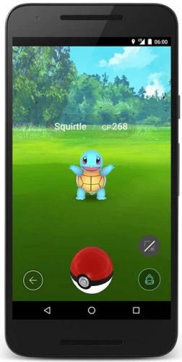


Images in Graphical programs
Icons
Textures and backgrounds
Other…

Slide 26
Use Documentation
We can’t learn everything from power point slides and instructors.
FLTK has documentation you can use:
http://www.fltk.org/doc-1.3/index.html

Slide 27
Image Files
We usually don’t want images “built into” our program binaries
We want to load them from files at run-time
That means we need:
File system support
Image format support
JPEG
PNG
GIF
BMP
etc.
}
Done for us by FLTK, with interfaces to OS

Slide 28
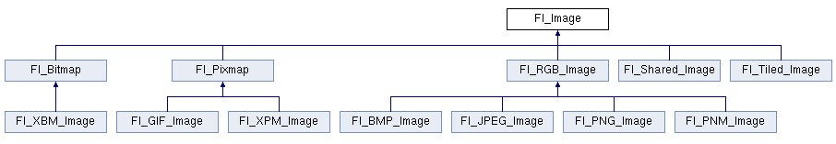
FLTK Image Classes
FLTK has container classes for familiar image formats

Slide 29
Loading Images with FLTK
Fl_JPEG_Image(const char* filepath);
Loads file automatically into an Fl_JPEG_Image object
If there are loading errors, FLTK sets image object’s width, height, and depth to zero
NOTE: file paths are relative and use unix-style path delimiter ‘/’
Different path origin when writing/debugging code than when executable is delivered

Slide 30
C-string Required
Fl_JPEG_Image(const char* filepath);
Note the const char*… Where have we seen that before?
Command line parameters.
If you have a c++ string, you can get a cstring from it.
string str = “Hello.jpg”;
Fl_JPEG_Image(str.c_str());

Slide 31
Drawing Images with FLTK
Fl_Widget::image(FL_Image);
You can attach an image to any widget as a label, just as it can with text
You can change the image for a widget at any time too
There is also a deimage(FL_Image) function that sets the image label for when the widget is “inactive”

Slide 32
Event Driven Programming
CSCE 121
J. Michael Moore

Slide 33
Procedural Programming
So far we’ve done procedural programming.
We control the flow of the program…

Slide 34
Event Driven
We respond to events.
Event framework controls the flow of the program.
Events
Sensor Data
Mouse Clicks
User input
Common in GUI (Graphical User Interface) Programming

Slide 35
Flow
Wait for Events
Event Loop
Process Event

Slide 36
Widgets
Widgets are anything placed into a window (e.g. Button, Box, Slider…)
When events occur they are directed to the appropriate widget.

Slide 37
Events
Mouse
Press / Release
Drag
Over
Keyboard
Timer
Resize
Not all listed

Slide 38
Processing Events
Write functions / methods to respond to particular events.

Slide 39
Getting Events (First Way)
Objects that receive events can override a handler function that is called when an event occurs for the widget.
The generic button does not know what we want it to do when it is pressed.
Generally we subclass the widget so we can add our own data members and functions.
In the child class we write a handler function that does the appropriate action.

Slide 40
Getting Events (Second Way)
Sometimes, other areas of code need to know when an event occurs with a particular widget.
We want to register with the widget to get notified when events occur in the widget we are watching.
Listener, Callback
After registering, any time the widget gets an event, the listener/callback is notified.

Slide 41
Getting Events (Second Way)
Some systems are more refined in the listener system.
In Java
You can register for specific types of events
You can have have multiple listeners.
With FLTK
You can only register for all events. In that case you have to check and make sure it is the right type of event.
Only one listener can be registered. You can overcome by letting the single listener inform others as well.

Slide 42
Starting a GUI program
Set up data and any GUI elements that need to be shown.
Start event loop.
Once loop is running, handlers and registered listeners / callbacks will be executed based on events that happen.
When those functions return, the event loop will continue.

Slide 43
Be Careful
Does not work like procedural programming.
Example: Dialogue window
Catch event to display Window. (return to event loop)
User inputs data into window and triggers an event. (e.g. “submit” button)
Catch event to “submit,” get data input into window, process data, and hide/close window. (return to event loop)
NOTE: return to event loop requires no special action, just end the function as we have always done.

Slide 44
Event Driven Programming Anatomy – Handle
CSCE 121
J. Michael Moore
Based on slides created by Carlos Soto.

Slide 45
Recall - Events
Mouse
Keyboard
Touch
Sensor events
Messages from other threads and programs (including the OS)
User-generated events. The “interactive” part of interactive programs

Slide 46
Events in FLTK
FLTK handles mouse, keyboard, and a few other events (such as clipboard-paste and window-fullscreen)
When “something happens” (like moving or clicking the mouse), FLTK generates an event
For example, an event is generated when a button widget is pressed
An FLTK button “knows” that it has been activated, and can “tell us”
It’s up to us to decide what to do when it happens
http://www.fltk.org/doc-1.3/events.html#events_model

Slide 47
The FLTK event loop
Fl::run();
Enters the FLTK event loop
waits for events (originating from the OS)
handles them
continues to wait for more events.
Loop continues until main window is closed

Slide 48
Handling Order
OS gets event (e.g. user event)
Event is sent to our program through FLTK
FLTK gives the event to a FL_Widget object (e.g. a button)
The FL_Widget object handles the event

Slide 49
Handling events
virtual int Fl_Widget::handle(int event);
We override handle in our own derived classes, thus defining the event-handling behavior
Never call handle() ourselves, FLTK does that for us
Return 1 if the event was “handled”
Return 0 if it was not (e.g. if it was not used)
Call parent’s handler if we don’t define what to do (avoid “short-circuiting”)

Slide 50
Overriding the handle() function
int MyClass::handle(int event) {
switch(event) {
case FL_PUSH:
// handle mouse press
return 1;
case FL_RELEASE:
// handle mouse release
return 1;
default:
return Fl_Widget::handle(event);
}
}
http://www.fltk.org/doc-1.3/subclassing.html#subclassing_events

Slide 51
Event Driven Programming Anatomy – Callbacks
CSCE 121
J. Michael Moore
Based on slides created by Carlos Soto.

Slide 52
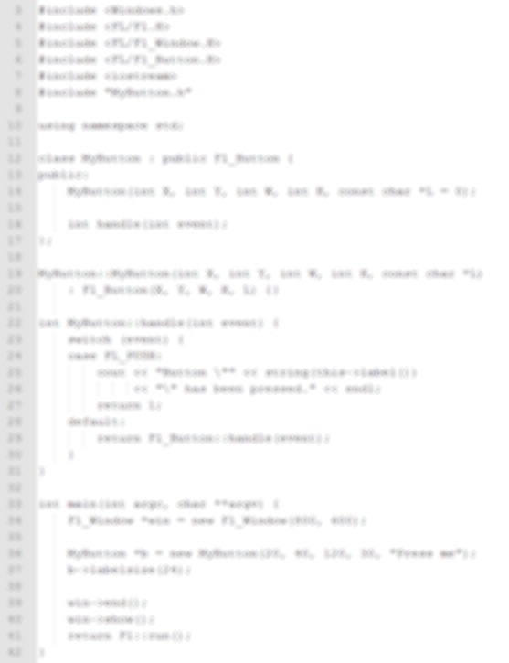
How event handlers actually work
FLTK registers handle() function with OS events
// something like:
// events.register(handle);
FLTK waits for events
Passing a function (i.e. some code) as an argument to another function
handle()
When an event occurs, FLTK calls the registered handle() function
main()
Fl:run();

Slide 53
Callbacks
A callback is a piece of code (usually a function) that is passed as an argument to another function.
In event-driven programming, a callback function is “called back” by the event loop when a particular event occurs.
handle() is internally a type of callback in FLTK

Slide 54
Fl_Widget Callbacks
In addition to handle() functions, each FLTK widget can register a single callback function.
The callback is triggered “when the value of the widget changes”
e.g. when a button is pressed when a window is closed when a slider is moved
What if you need more than one callback?
Make one callback that calls uses logic to call other functions.

Slide 55
Fl_Widget Callbacks
Callback function must have
global scope
void mycallback_function() {
// do something
}
int main() {
Fl_Button b(x, y, w, h);
b.callback(mycallback_function);
}
Registration
Still, not quite right…
Check documentation…
The “callback” function (inherited from Fl_Widget) tells the button what code to call when the button “changes” (i.e. when it is clicked)

Slide 56
How do we pass a function as an argument?
void Fl_Widget::callback(Fl_Callback* cb);
typedef void(Fl_Callback)(Fl_Widget*, void*);
The “type” of the function we need to pass
i.e. the function’s signature (minus its name)
Return void
A “pointer to anything”
A pointer to a Fl_Widget
Notes:
Here’s the signature for callback, straight from the FLTK documentation. We can see that it expects an argument that is a pointer to something called an Fl_Callback. We that callback takes in a function, so Fl_Callback is the TYPE of the function that we need to pass in. More specifically, it tells us what the function SIGNATURE needs to be.
So let’s take a look at what Fl_Callback is. This probably looks weird, and that’s because it is. This is something called a FUNCTION POINTER, and it’s what allows us to pass a function as an argument. It works because functions are just blocks of code in memory, and we can get their address just like we can get the address of an object. By putting that address in a pointer, we can pass it as an argument.
The syntax for function pointer definitions is unfortunately really ugly, but they tell us what the function’s parameters are and what it returns. So functions of type Fl_Callback return void, and take two parameters: A pointer to an Fl_Widget, and a void pointer, which is actually a raw memory address and therefore a pointer to anything.

Slide 57
Defining an FLTK widget’s callback
void mycallback_function() {
// do something
}
int main() {
Fl_Button b(x, y, w, h);
b.callback(mycallback_function);
}
Incorrect Signature!

Slide 58
Defining an FLTK widget’s callback
void mycallback_function(Fl_Widget* w, void* v) {
// do something
}
int main() {
Fl_Button b(x, y, w, h);
b.callback(mycallback_function);
}

Slide 59
The arguments passed to our callback function
void mycallback_function(Fl_Widget* w, void* v) {
Fl_Button* b = dynamic_cast<Fl_Button*>(w);
b->label("The button was clicked");
b->redraw();
}
A pointer to the widget that triggered the callback

Slide 60
What about the second argument?
Can contain a pointer to another widget
void mycallback_function(Fl_Widget* w, void* v) {
OtherWidget* ow = static_cast<OtherWidget*>(v);
}
void Fl_Widget::callback(Fl_Callback* cb, void*);

Slide 61
Using callbacks with another widget
void mycallback_function(Fl_Widget* w, void* v) {
Fl_Button* b = dynamic_cast<Fl_Button*>(w);
Fl_Output* out = static_cast<Fl_Output*>(v);
// do something with widgets b and out
}
int main() {
Fl_Button b(x1, y1, w1, h1);
Fl_Output out(x2, y2, w2, h2);
void* out_voidp = static_cast<void*>(out);
b.callback(mycallback_function, out_voidp);
}

Slide 62
Using callbacks with another widget
void mycallback_function(Fl_Widget* w, void* v) {
Fl_Button* b = dynamic_cast<Fl_Button*>(w);
Fl_Output* out = static_cast<Fl_Output*>(v);
// do something with widgets b and out
}
int main() {
Fl_Button* b = new Fl_Button(x1, y1, w1, h1);
Fl_Output* out = new Fl_Output(x2, y2, w2, h2);
b.callback(mycallback_function, out);
}

Slide 63
Using callbacks with another widget
void mycallback_function(Fl_Widget* w, void* v) {
Fl_Button* b = dynamic_cast<Fl_Button*>(w);
Fl_Output* out = static_cast<Fl_Output*>(v);
// do something with widgets b and out
}
int main() {
Fl_Button* b = new Fl_Button(x1, y1, w1, h1);
Fl_Output* out = new Fl_Output(x2, y2, w2, h2);
b.callback(mycallback_function, static_cast<void*>(out));
}

Slide 64
Callbacks and Handles in the same program
When you define a handle() function for a derived class of Fl_Widget
the callback() function for that class is disabled.
Enable it by calling do_callback(); in your handle function, just before return 1;
If you don’t, then the callback will not execute!

Slide 65
Callbacks as class members
Must be a static member function
Will give it global scope.
Recall, static members are not bound to any particular object of the class type. They belong to the class itself.
Called with scope-resolution operator e.g. MyClass::my_static_function();
Access to this is no longer implicit
Must be passed to callback and cast back to proper type

Slide 66
Callback as static member function
class MyClass {
static void button_cb(Fl_Widget* w, void* data) {
MyClass* cbthis = static_cast<MyClass*>(data);
// can access MyClass members through cbthis
}
public:
MyClass() {
button = new Fl_Button(...);
button->callback(button_cb, static_cast<void*>(this));
}
};

Slide 67
Abstract Data Type (ADT)
CSCE 121
J. Michael Moore

Slide 68
Abstract Data Type
zyBook: a data type whose creation and update are constrained to specific well-defined operations.
Wikipedia: a mathematical model for data types where a data type is defined by its behavior (semantics) from the point of view of a user of the data, specifically in terms of possible values, possible operations on data of this type, and the behavior of these operations.
Goodrich, et al.: a mathematical model of a data structure that specifies the type of the data stored, the operations supported on them, and the types of the parameters of the operations.

Slide 69
Abstract Data Type
What
Not How

Slide 70
Example: Stack
Last in first out (LIFO)
Think PEZ dispenser
Operations:
Push(e): Insert item on top of stack
Pop(): Remove item from top of stack
Peek(): Look at item on top of stack (does not remove)

Slide 71
Example Queue
First in first out (FIFO)
Lines at amusement park
Operations:
Enqueue(e): Insert at the end of the queue
Dequeue(): Remove from the front of the queue (i.e. the oldest one)
Front(): Return from the front of the queue, but do not remove

Slide 72
zyBook Example: Vector
Operations
at(index)
size()
empty()
clear()
push_back(element)
erase(index)
insert(index, element)

Slide 73
Data Structure
Data structure, the specifics of how data is organized.
Array
Linked List
With an ADT, the data structure does not have to be specified.
Vector ADT
Array???
Linked List???

Slide 74
In C++
Generally the public interface, i.e. the public members of a class.

